Slide 1


Slide 2
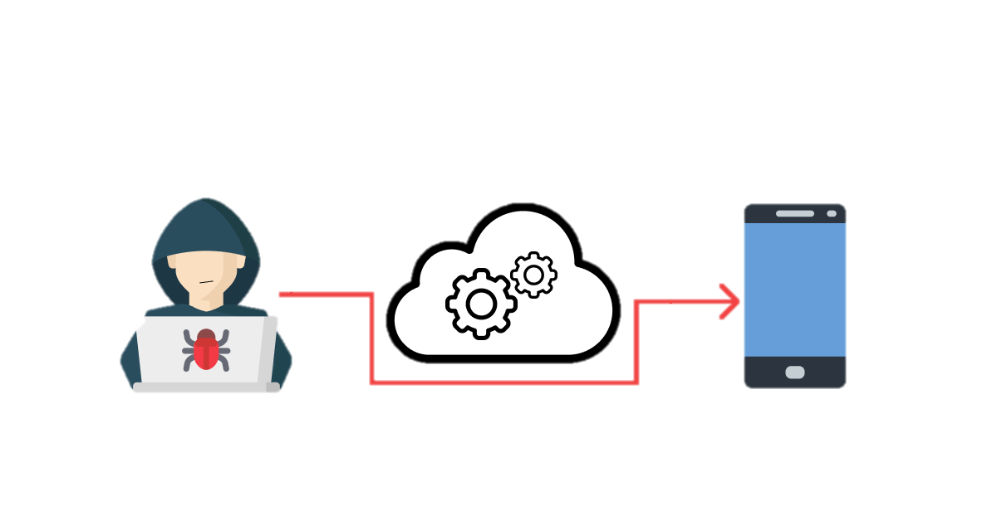

Business Logic Flaws

Slide 3

What is Business logic bugs?
Business logic vulnerabilities are flaws in the design and implementation of an application that allow an attacker to elicit unintended behavior. This potentially enables attackers to manipulate legitimate functionality to achieve a malicious goal.

Slide 4
Business Logic bugs
1) ATO via Google SSO signup function
2) Parameter Tampering
3) Response Manipulation
4) Critical Parameter Manipulation and Access to Unauthorized Information/Content (IDOR)

Slide 5
ATO via Google SSO signup function
Google SSO function misbehave for signup function leads to Pre-Auth Account takeover
What is Login? Login simply means to validate the user, like authenticating the user. It means the user is identified and authenticated to access the website or a program where he/she is already registered.
What is Sign Up? Sign up is an action to register yourself for a new account. Different web portals might use different terms for returning users, but they all use “sign up” for the process of first-time registration

Slide 6
Steps to reproduce:
Create account with form on any site where Google SSO is merged
Now login and log out to verify its working or not
Now go to signup and click on google SSO function for same email id which we created already on same site and you will directly in account
go to site.com/account/settings etc

Slide 7
Impact or how an attacker will exploit this:
Since there is no email confirmation, an attacker can easily create an account in the application using the Victim’s Email. This allows an attacker to gain pre-authentication to the victim’s account.
Further, due to the lack of proper validation of email coming from Social Login and failing to check if an account already exists, the victim will not identify if an account is already existing. Hence, the attacker’s persistence will remain. In this Google must say email already exists or access denied The overall severity usually lies from High to Critical depending upon the data that is being stored.

Slide 8
Parameter Tampering
Using this vulnerability you can change the amount of any product, which leads to Financial loss for the company.
Steps to find this bug:-
1) Intercept on and click on the product you want to buy.
2) find amount parameter and change the value.
3) Forward and keep changing amount.
4) If the amount you changed is shown in the browser then it is vulnerable.

Slide 9
Response Manipulation bugs
When talking about response manipulation we are talking about a technique that is used to make the target display some UI elements it shouldn't. It can be used to find new endpoints, buttons, and also to trigger some new requests. Sometimes you can also bypass Password restrictions or OTPs.
Steps:-
1)To test this vulnerability we need 2 Accounts 2) First Try Login in as Attacker account with correct credentials and capture the request and copy the response of it. 3) Now try to login using Victim account but with random password and capture the request. 4) Now replace the response with the attackers response and you will be able to login without using the actual password of the victim.
Same this you can try with OTP also

Slide 10
Critical Parameter Manipulation
HTTP, GET & POST requests typically have parameters, which can be in the form of name/value pair, JSON, XML etc.
If the application is processing the parameters before validating them, it leads to information disclosure as these parameters can be guessed/predicted and tampered with.

Slide 11
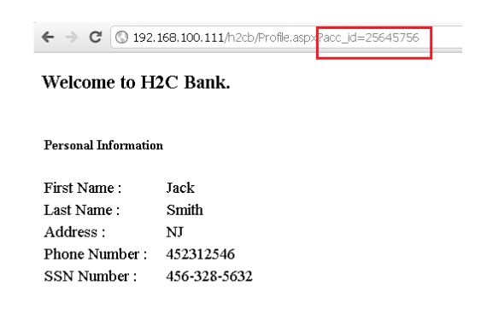
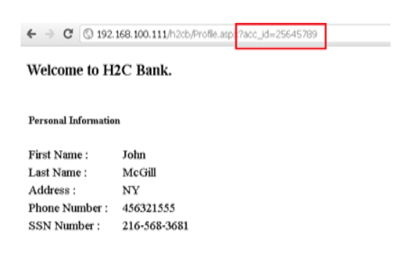

Slide 12
Steps to reproduce:
Through a proxy, observe HTTP traffic.
POST/GET requests would have typical parameters either in name-value pair, JSON, XML or Cookies. Observe the values in the traffic and look for incrementing numbers and easily guessable values across all parameters.
This parameter’s value can be changed and one may gain unauthorized access.

Slide 13
Thank
You

